Slide 1
NES Project – Task 4 Stage Rendering
Daniel José Febles Bustillo

Slide 2
Video Objectives
Refactoring code to be more organized and readable
Implementing new ROM data for the stages
Drawing screens by using multiple subroutines
Using bit manipulations in order to isolate important data
Making the most out of zero page for extra parameters
Transforming data to maximize use and reduce ROM space
Show the results of the process

Slide 3
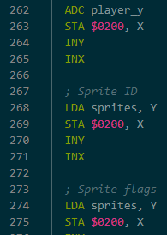
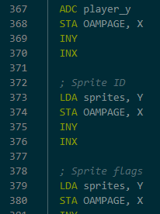
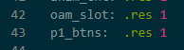
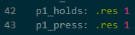
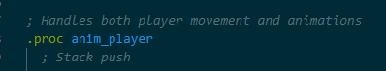
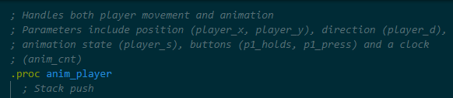
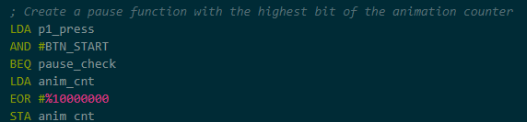



Refactoring Code
“It isn't broken, then don’t fix it,” but it could be better
Improve the structure of the code
Convert commonly used addresses into constants
Remove redundant variables and spit more complex ones in two
Adjust documentation so that things are clearer when describing routines and their parts
Though seemingly trivial, makes revising and debugging code much easier
Better structures mean better tools to work on new features

Slide 4
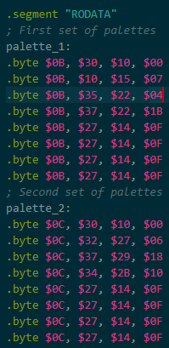
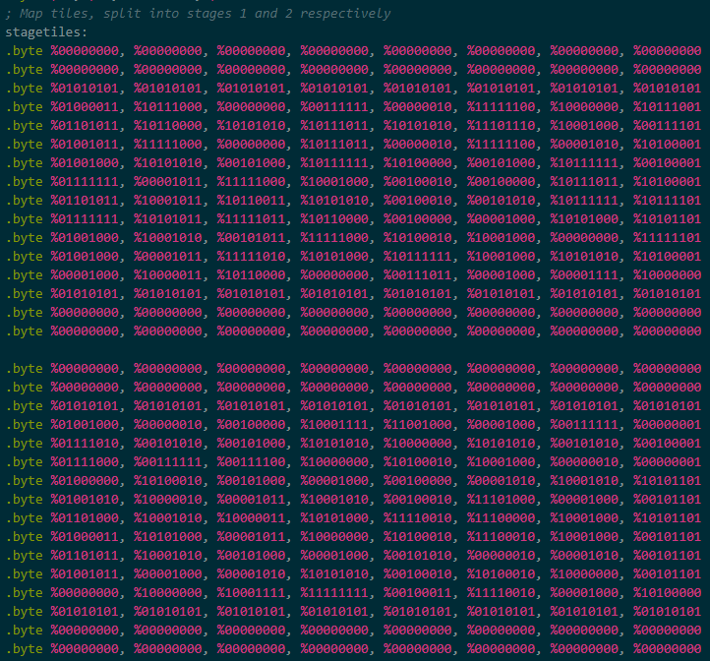
Stage Data for the ROM
Stage data, even with compression techniques, tends to be massive
We use two bits to identify each metatile on the grid
That seems strict, but even then, two stages with two screens each takes up an entire page
This doesn’t even include attribute table data, which will be extracted from the stage data
We also create a new set of palettes for the second stage to use
Comparatively, palette data is much more cost efficient

Slide 5
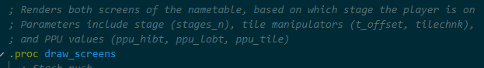
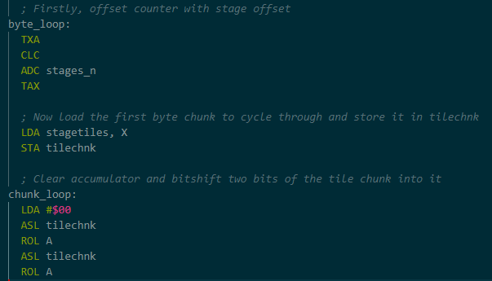
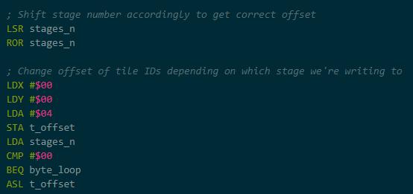
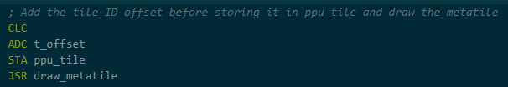
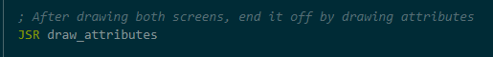
Drawing Screens Is Hard
Drawing screens on a nametable is technically linear, but most compression methods make it non-linear
Make the main function linear for simplicity (draw_screens) but then make helper functions do all the non-linear work (draw_metatiles, draw_attributes)
That way, the main body becomes simple to process while isolating the clunkier parts for better analysis
Data is stored in bytes but needs to be used as bits
Isolate necessary bits via rotations and other bit operands
Makes bytes usable for bit storage and prevents us for wasting space by having the two bits take up whole bytes on their own

Slide 6
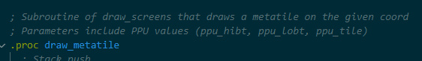
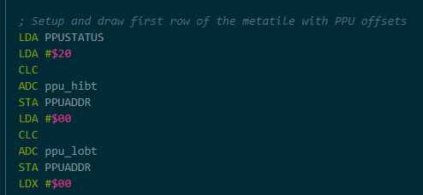
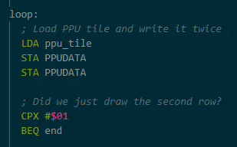
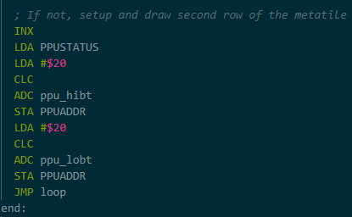
Metatiles and Parameters
Metatiles are made up of four tiles, but writing between rows of tiles requires jumping a lot
Specifically make parameters for memorizing locations
Use zero page to create these parameters for fast access
Now we can integrate the jumps into the code itself for convenience
Generic parameters can also be used for other subroutines without losing clarity
This helps take up less space in zero page while not sacrificing readability

Slide 7
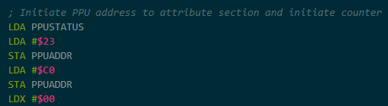
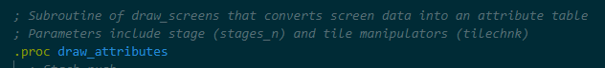
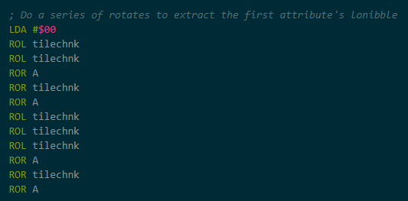
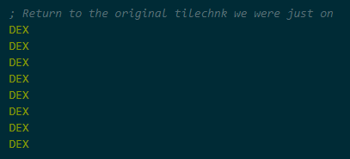
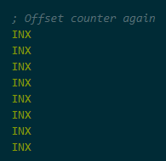
Turning Screen Data into Attributes
Coincidentally, attribute table also take up two bits per attribute (four attributes per bytes)
Attributes are stored at the end of a nametable, which means it should be written after setting up the entire screen
Each byte color codes a 2x2 block of metatiles with one of the four palettes, making them inherently non-linear
Manipulate data once again with bit operands
Need to jump around screen data a lot
Once again, have the jumps be part of the code
Attribute data is a lot more simplistic, so just using the registers is fine

Slide 8
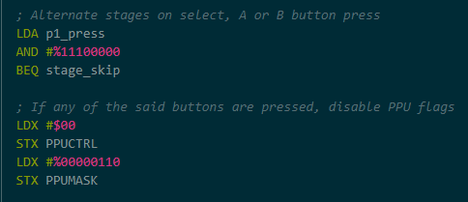
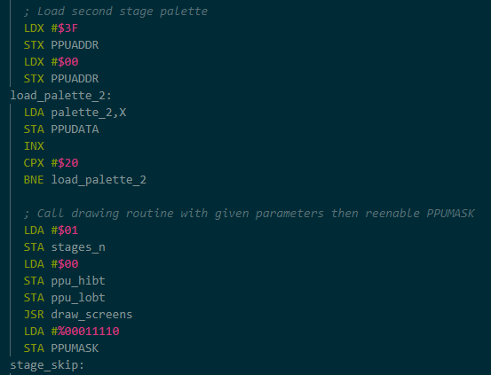
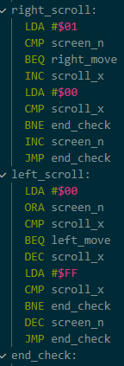
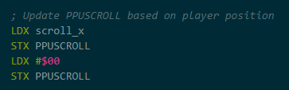
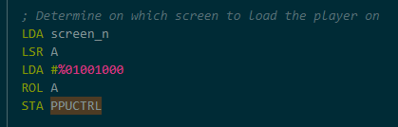
Showing the Screen Data
We have four screens of data total, but can only show two at a time
Use button presses to change from one stage to another
Also need to properly scroll and show all the data
Use player movement to scroll the screen
Create a scroll-line by using a specific part of the x-axis to move the screen along
Scroll offset is determined by PPUSCROLL, while which screen is in focus is determined by PPUCTRL

Slide 9
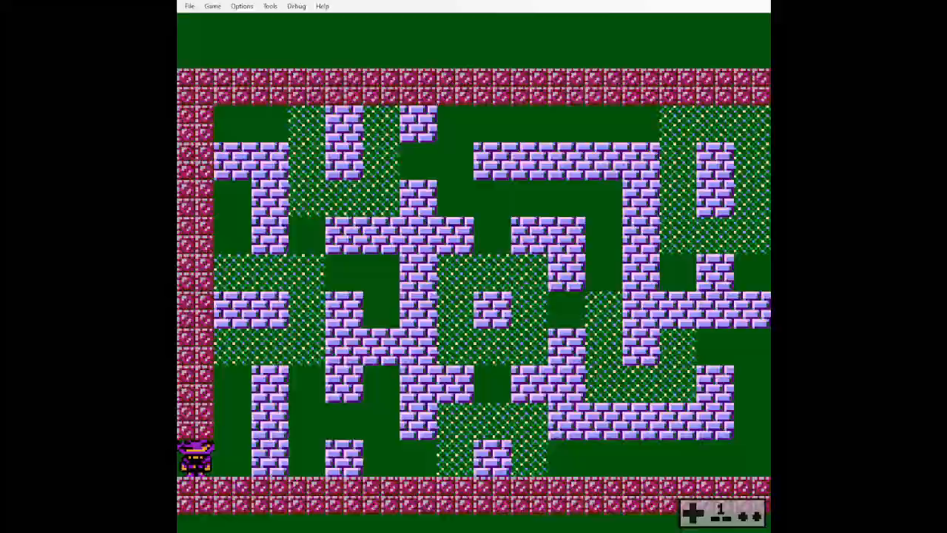
Final Result

Slide 10
Thank you for your attention

